Slide 1

DEPARTMENT OF COMPUTER SCIENCE AND ENGINEERING
AND INFORMATION TECHNOLOGY
MAJOR PROJECT
STREAMLINING RECRUITMENT:NLP-POWERED RESUME SHORTLISTING
SECTION : IT-A
BATCH : : 10
 | Name | Roll No
1. | G.SRIJA | 21BK1A1241
2. | G.KISHORE | 21BK1A1237
3. | K.VIJAY KUMAR | 21BK1A1260
4. | D.NAVEEN | 21BK1A1231
PROJECT GUIDE
Mrs. T. MANASA

Slide 2
MINISTRY OF HOUSING AND URBAN AFFAIRS

Slide 3
PROBLEM STATEMENT
The Ministry of Housing and Urban Affairs (MoHUA) is tackling two significant issues: urban overcrowding and rural deprivation. These challenges are distinct yet interconnected. In cities, rapid population growth leads to problems like congested infrastructure, limited access to housing, and overstretched public services. Meanwhile, in rural areas, there is often a lack of development, with poor access to basic services, education, healthcare, and employment opportunities . The project’s goal is to create a solution that addresses these issues by promoting sustainable and integrated development. This means that any development should not only meet the immediate needs of today’s population but also be designed to support future growth without depleting resources. The term "integrated development" implies a holistic approach, where urban and rural areas are developed in tandem, ensuring that the progress in one does not come at the expense of the other .The project will focus on enhancing infrastructure, which refers to improving physical structures like roads, public transport, water supply, and sanitation systems, in both urban and rural areas. It also seeks to ensure that people, regardless of where they live, have equitable access to essential services like education, healthcare, and housing.

Slide 4
PROPOSED SOLUTION
Enhanced Accessibility: Users can log in securely using OTP and submit complaints conveniently via audio files or text, supporting multiple languages (English, Telugu, Hindi).
Real-Time Tracking: Citizens can track the status of their complaints in real time, promoting transparency and accountability.
Efficient Complaint Resolution: Admins can view and update complaint statuses promptly, improving response times and overall service delivery.
User-Friendly Interface: The Chatbot offers an intuitive interface, enhancing user experience and engagement.
Multilingual Support: Supports complaints in English, Telugu, and Hindi, catering to linguistic diversity among users.

Slide 5
EXISTING SOLUTIONS VS PROPOSED SOLUTIONS
The existing system for handling complaints at MoHUA relies on manual processes such as in-person visits or written submissions, which are slow, prone to errors, and lack transparency in tracking complaint statuses. Citizens face limited communication options and language barriers, as submissions are typically restricted to one or two languages. In contrast, the proposed system offers enhanced accessibility through OTP-secured logins and digital submission options via audio or text files, supporting multiple languages (English, Telugu, and Hindi). It enables real-time tracking of complaint statuses, provides a user-friendly chatbot interface for ease of use, and allows admins to resolve complaints faster by automating updates, ultimately improving transparency, efficiency, and inclusivity.

Slide 6
TECHNOLOGIES USED
SOFTWARE REQUIREMENTS:
• Working framework : Windows8 or above.
• Coding language : Python
• Front end : HTML/CSS
• Backend : MySQL
• IDE : PyCharm
• Server : Django
HARDWARE REQUIREMENTS:
Framework : i3 or above.
RAM : 4 GB.
Hard disk : 40 GB

Slide 7
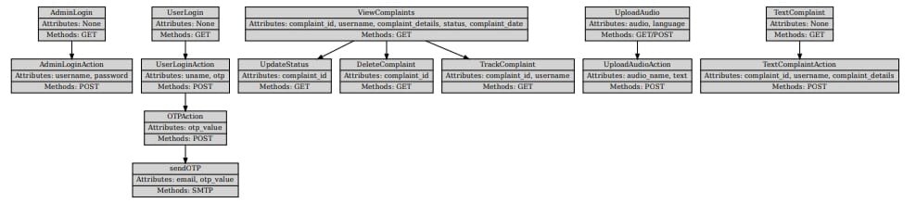
UML DIAGRAMS
CLASS DIAGRAM :

Slide 8
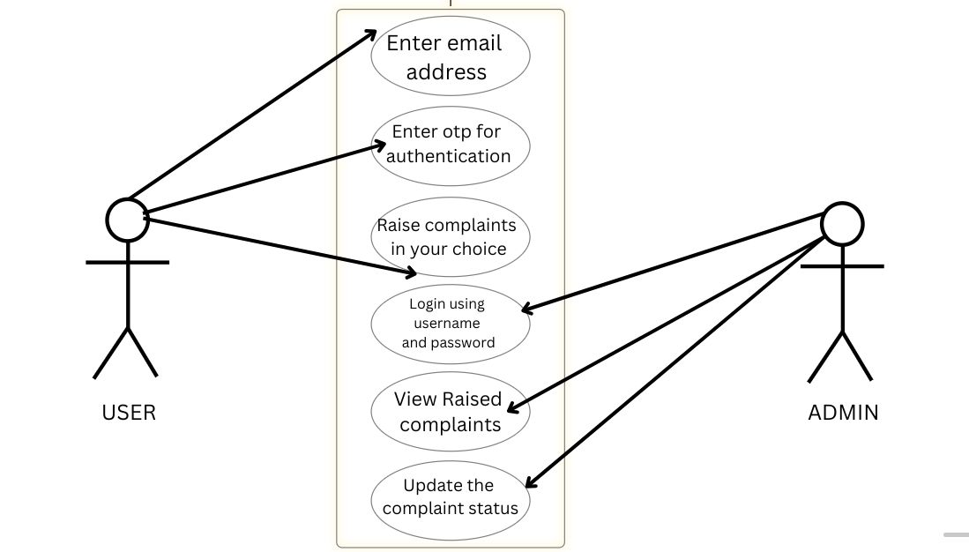
UML DIAGRAMS
USECASE DIAGRAM:

Slide 9
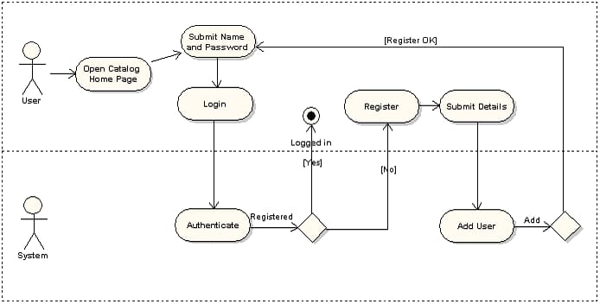
UML DIAGRAMS
ACTIVITY DIAGRAM :

Slide 10
TESTING METHODOLOGIES
UNIT TESTING :
Unit testing is a software testing technique where individual components or units of a
program are tested in isolation from the rest of the application. The goal is to ensure that
each unit of the code (typically a function, method, or class) performs as expected. Unit tests
are typically automated and written by developers during or after writing code.
TEST CASES :
Test Case 1: OTP Generation Function:
User Login Action Test Case Objective: Verify that an OTP is generated and sent to the user email.
Input: User submits login form with email.
Expected Output: OTP is sent to the email.

Slide 11
Test Case 2: Admin Login Function:
Admin Login Action Test Case Objective: Validate that the admin login works with correct credentials.
Input: Username: "admin", Password: "admin“
Expected Output: Successful login.
Test Case 3: Complaint SubmissionFunction:
Text Complaint Action Test Case Objective: Ensure complaints are submitted correctly by users.
Input: Complaint text.
Expected Output: Complaint is inserted into the database.
Test Case 4: Complaint Status UpdateFunction:
Update Status Test Case Objective: Validate that the admin can update complaint status.
Input: Complaint ID.
Expected Output: Status of the complaint changes to "Completed“.

Slide 12
Test Case 5: View Complaints Function:
View Complaints Test Case Objective: Check if the admin can view pending complaints.
Input: None.
Expected Output: All pending complaints are displayed.

Slide 13
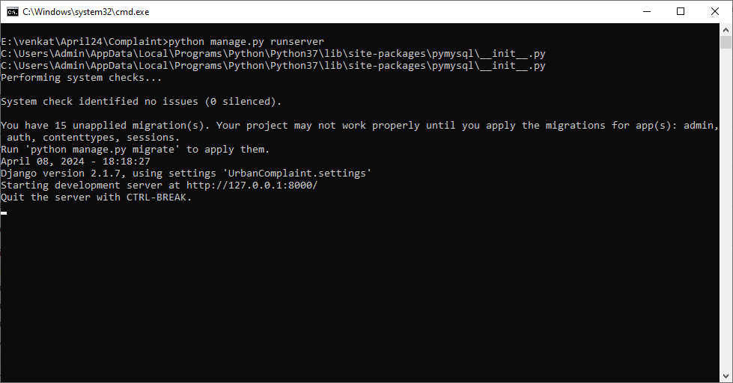
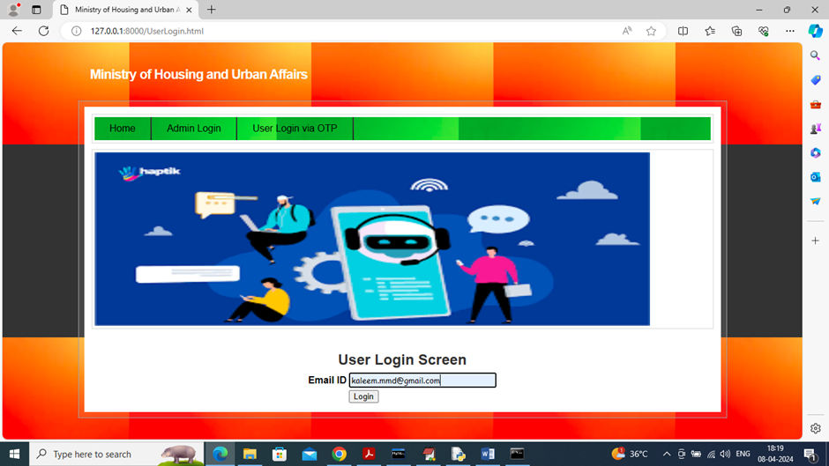
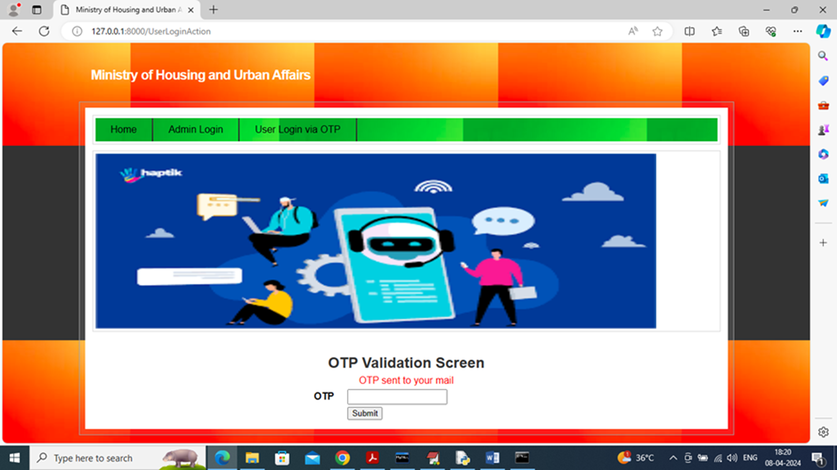
PROJECT OUTPUT

Slide 14
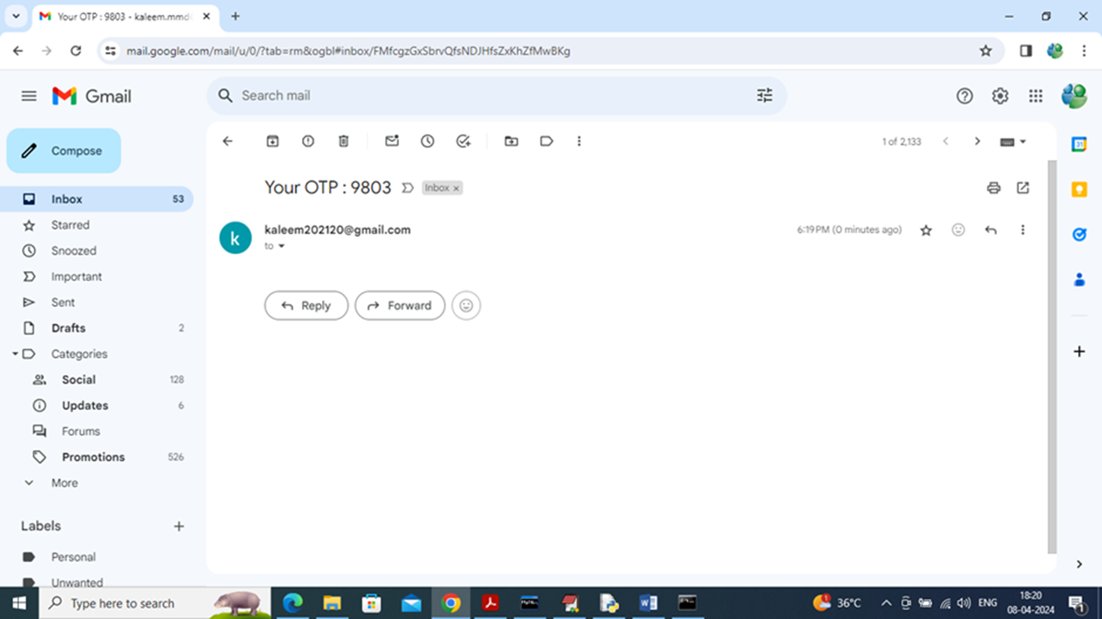
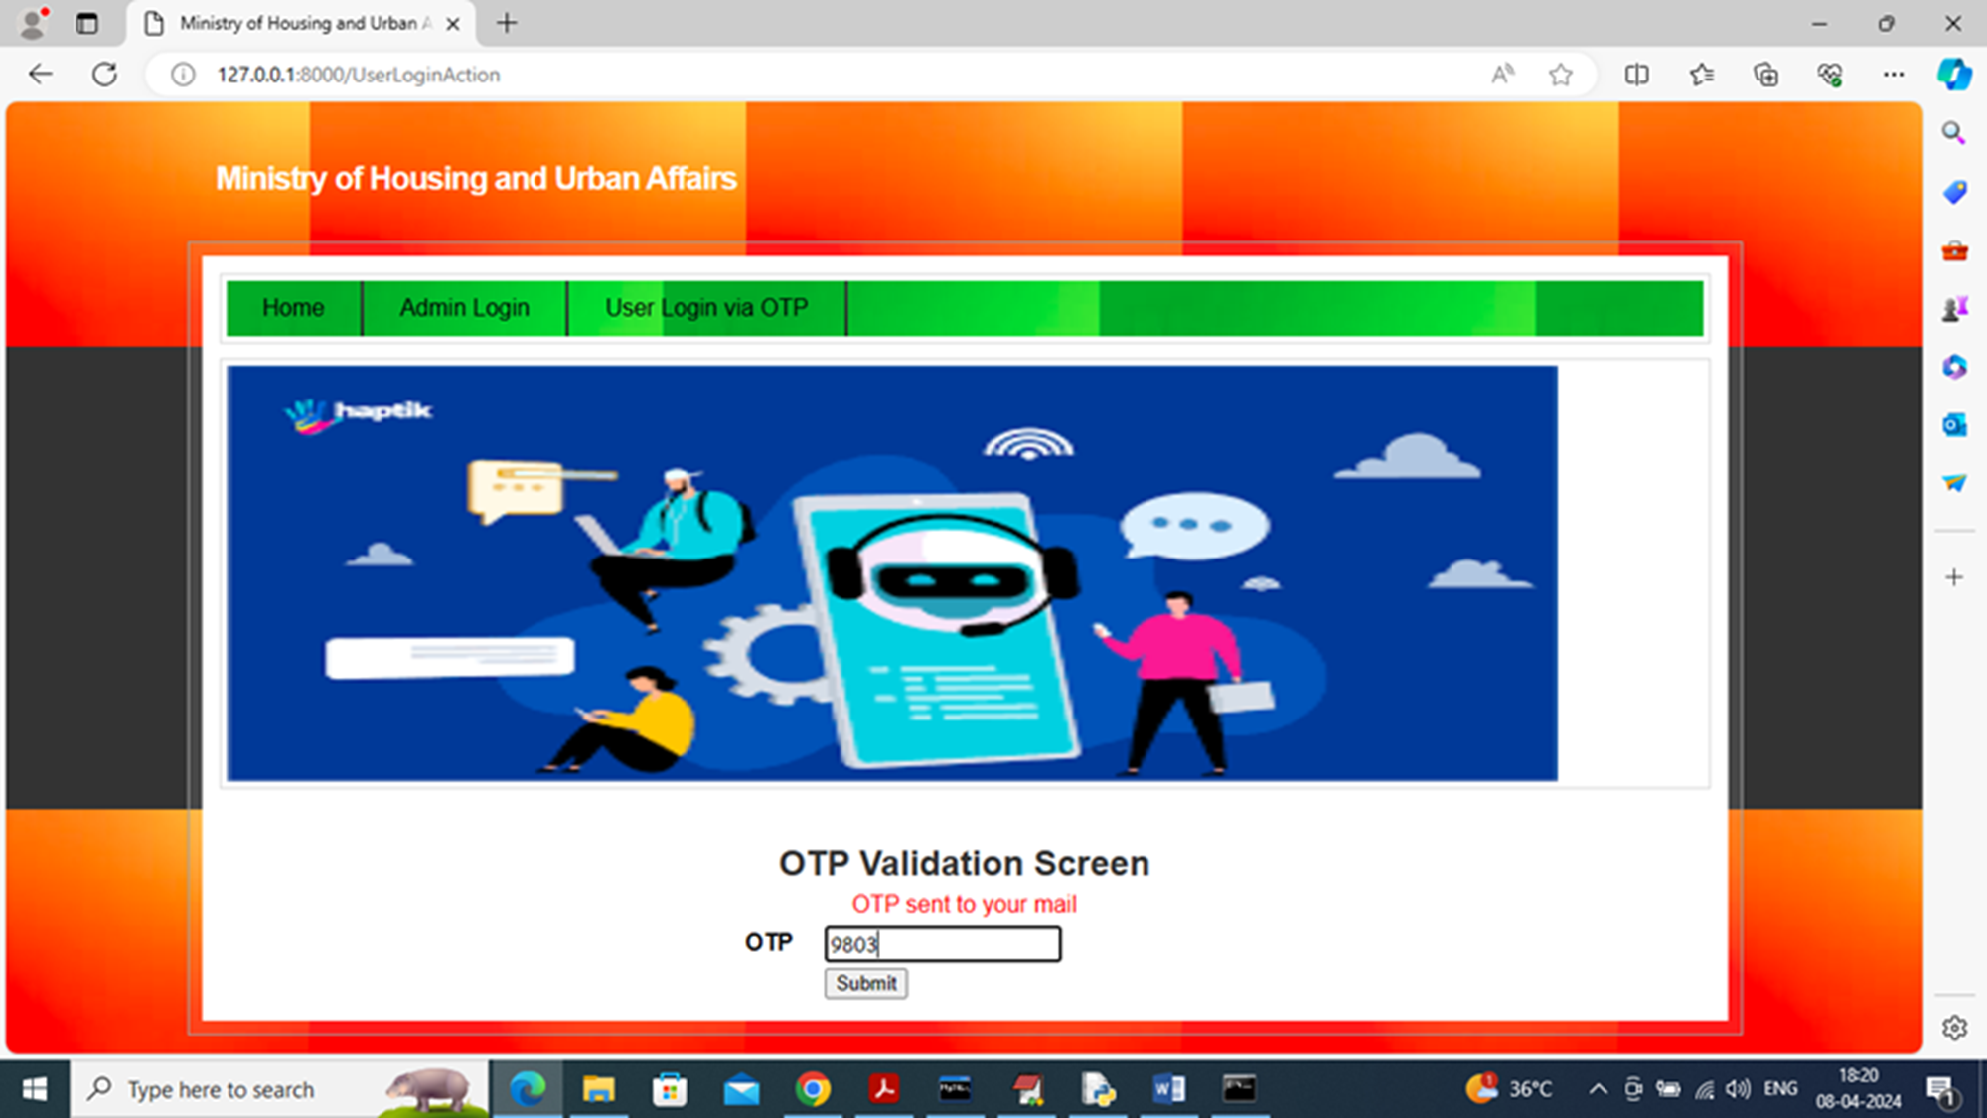
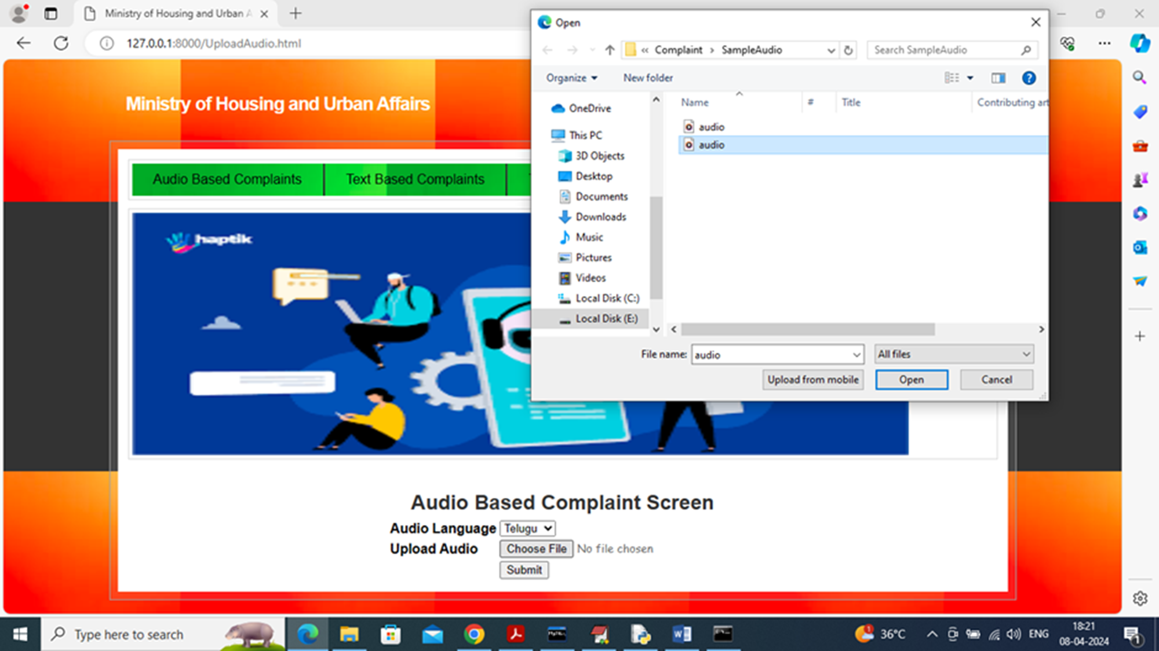
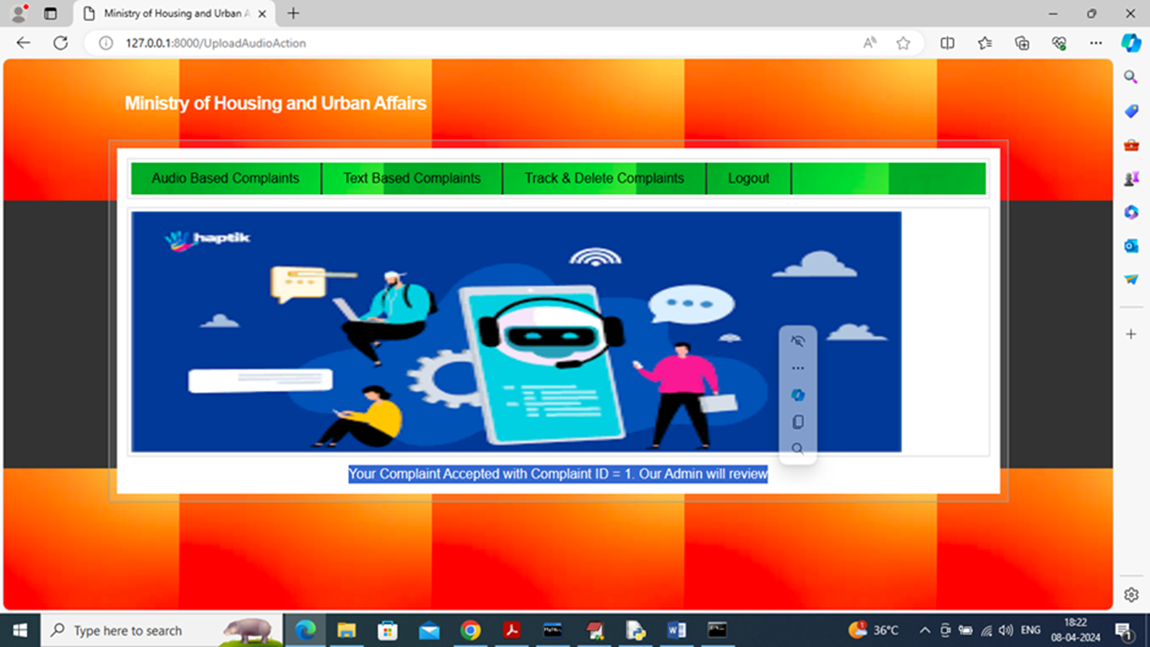

Slide 15
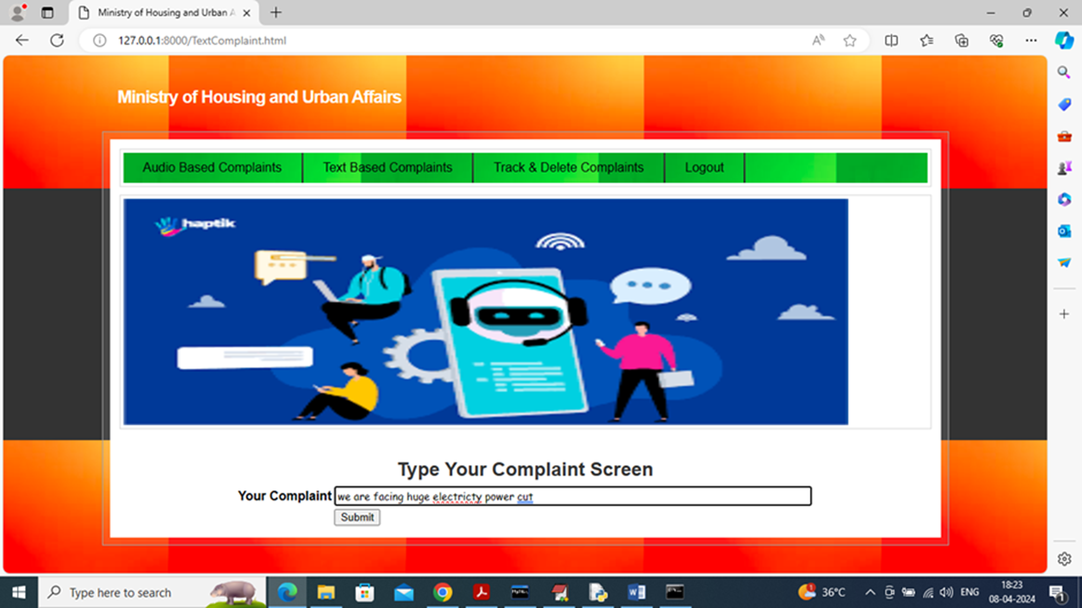
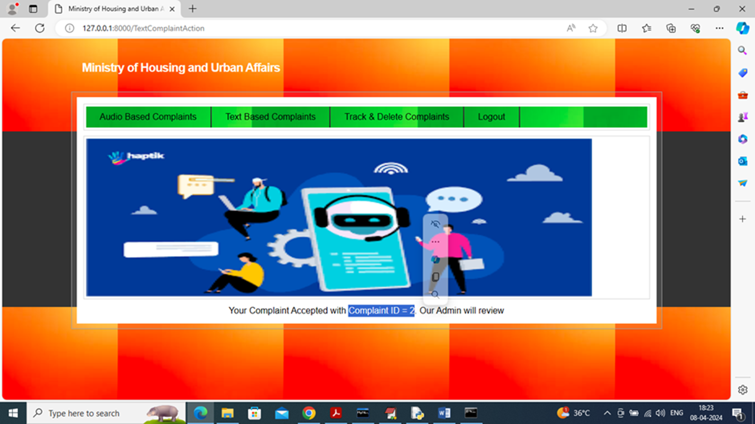
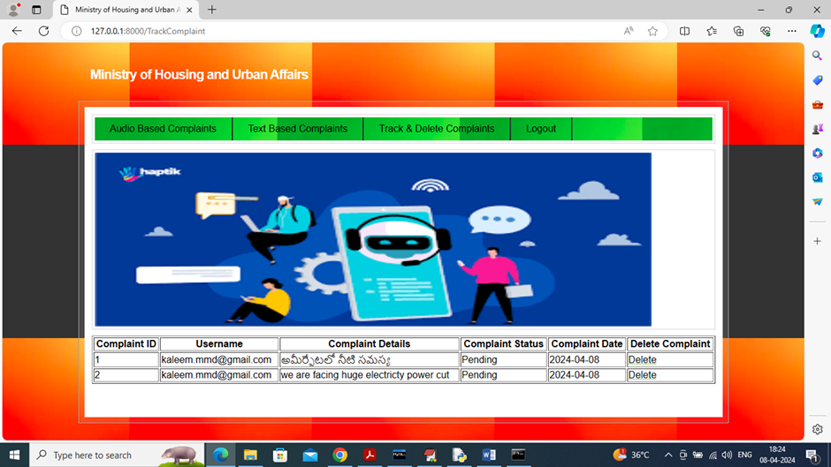


Slide 16
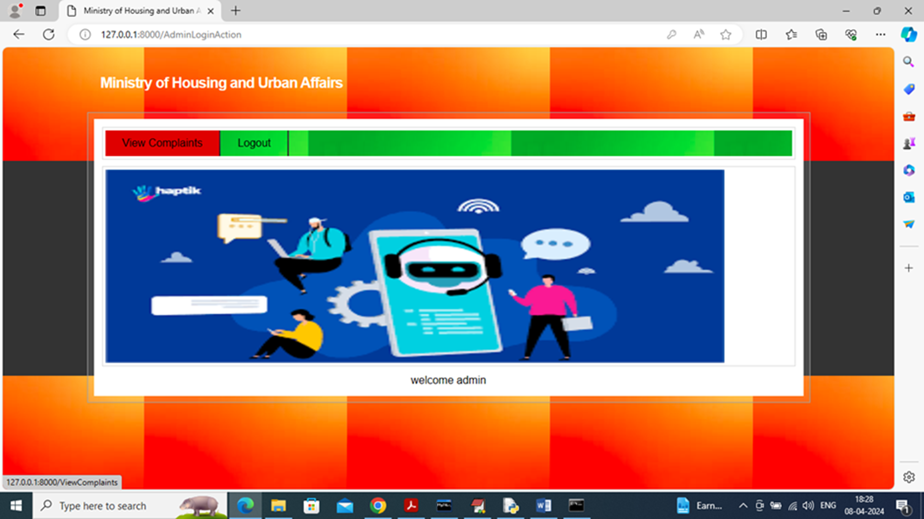
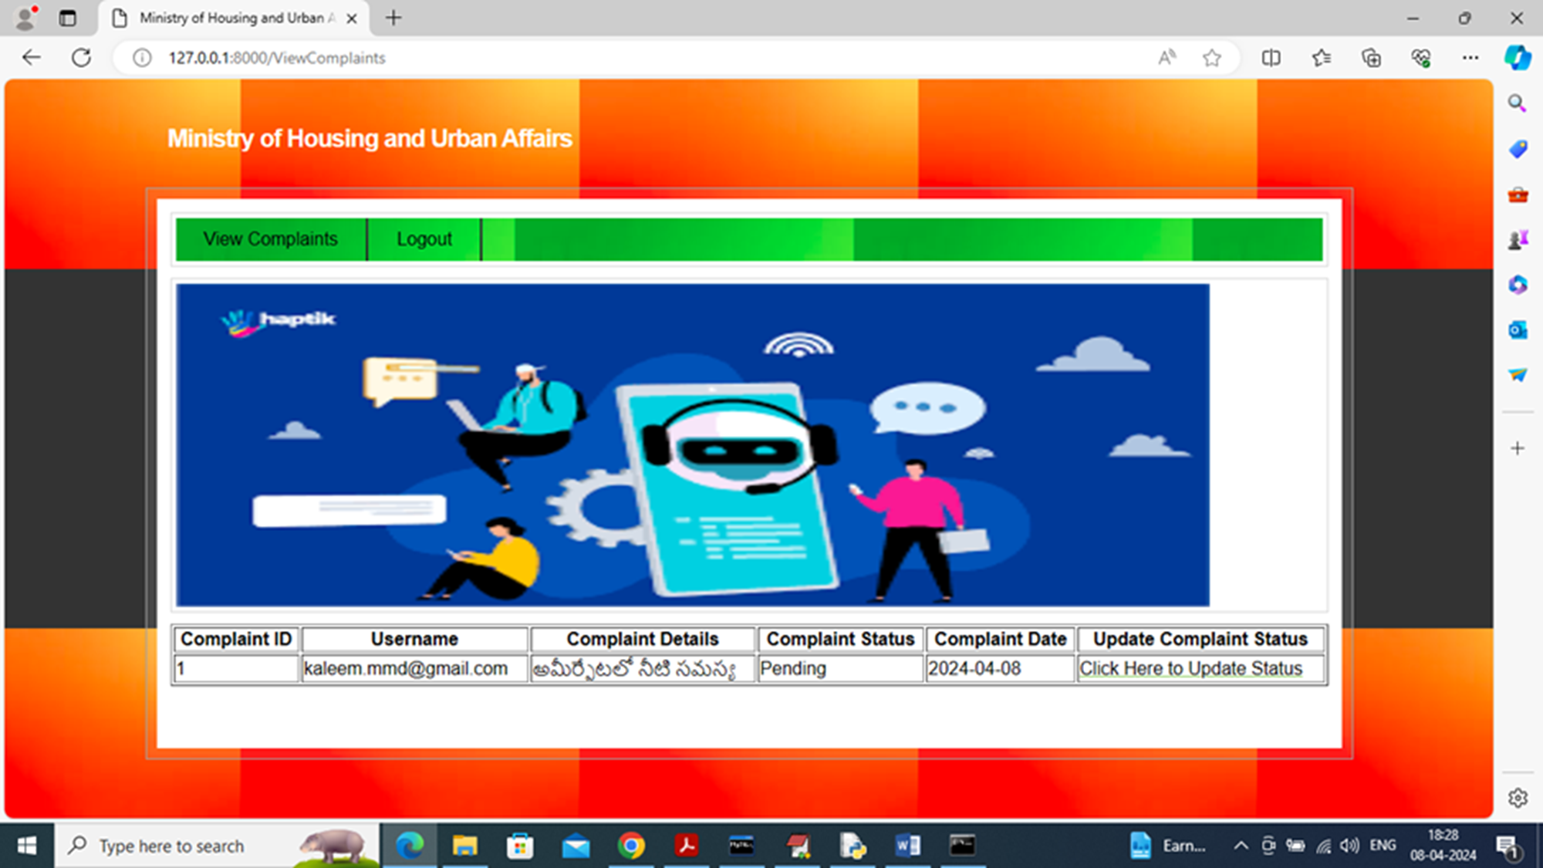
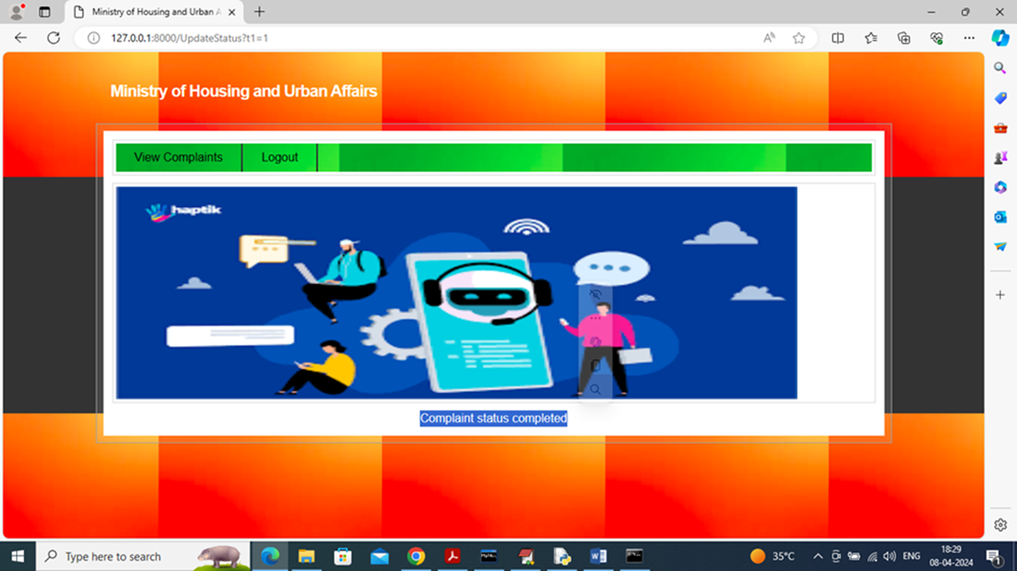


Slide 17
BENEFITS AND LIMITATIONS
BENEFITS:
Efficiency: Automates complaint handling processes, reducing manual effort and streamlining operations.
Transparency: Provides real-time status updates to users, ensuring transparency in grievance redressal.
Accessibility: Enables easy access to complaint submission and tracking services via digital platforms.
Enhanced User Experience: Offers a user-friendly interface with multilingual support, improving accessibility and user satisfaction.
LIMITATIONS:
Manual Processes: Reliance on manual handling of complaints can lead to delays and inefficiencies.
Lack of Transparency: It may be difficult for citizens to track the status of their complaints in real time.
Administrative Burden: Admins may struggle with managing and resolving complaints effectively due to the absence of centralized digital tools.

Slide 18
FUTURE SCOPE
The future scope of AI-driven governance systems is incredibly exciting! By integrating AI-driven
sentiment analysis, these systems can gain a deeper understanding of public concerns, allowing for
more effective and responsive decision-making . This technology can process vast amounts of data
from diverse sources in real-time, detecting subtle emotional nuances and identifying emerging trends .
Key Enhancements:- Expanded Language Support: Reach more citizens by supporting multiple languages, ensuring inclusivity and accessibility.
Emerging Technology Integration: Leverage technologies like blockchain, IoT, and augmented reality to enhance transparency, accountability, and service delivery.
Predictive Analytics: Use machine learning algorithms to forecast potential issues and opportunities, enabling proactive governance and improve governance in the years to come.

Slide 19
CONCLUSION
The Chatbot-based complaint management system developed for the Ministry of Housing and Urban Affairs (MoHUA) marks a transformative advancement in urban governance by significantly enhancing both citizen engagement and administrative efficiency. It integrates user-friendly features like OTP-based login for secure access, and multilingual support including English, Telugu, and Hindi, catering to a diverse population. The inclusion of audio and text-based complaint options ensures accessibility for citizens with varying levels of literacy and technological proficiency. The system's real-time tracking of complaint statuses promotes transparency, allowing citizens to monitor the resolution of their grievances, thus building trust in the system. For administrators, the dashboard streamlines complaint management by enabling timely updates, prioritizing tasks, and ensuring efficient resource allocation. Moving forward, the system can be further enhanced through AI-driven sentiment analysis, which would enable a deeper understanding of public concerns, and expanded language support to reach more citizens. These future developments, along with potential integration with emerging technologies, will reinforce the system's role as a central platform for effective, responsive, and citizen-centric governance, promoting accountability and improving service delivery across urban areas.
PROJECT GUIDE

Slide 20
THANK YOU

